Slide 1

17th January, 2018
OptumRx – 2018 Focus & Plan

Slide 2
Agenda
1. Reflections 2017
2. Our Path forward – 2018 Focus Areas
A. Quality
B. Delivery Transformation
C. Value Delivery
D. Capability Building
E. People
3. Appendix

Slide 3


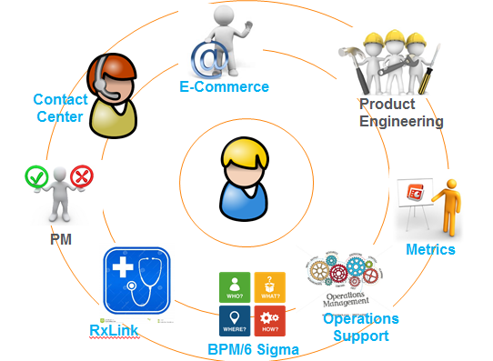






2017 - Reflections
Cost
Blended Rate reduction by 31%
Test Automation
Regression Automation @85%
Hybrid COE’s
4 pilots conducted
TTB, TTV measurement in place
Capability
60+% penetration in key domains in Rx
Seeded Engineering roles
AS400, AbInitio, KANA capability built
Innovation
2 ideas in Product Roadmap
Aligned to DiGiT
Quality
99.933% System Availability
0.03 Production defect density
Problem Backlog Reduction by 50%
Business Value
↑ ePA penetration to 28.3%
1M Dr First Benefit check transactions
↑Digital Property orders growth 16%
↑Digital Revenue growth 23%
# of Agile Teams
15 agile teams, 2 independent Scrum teams
Aligned to Rx Roadmap
People
83% Vital Signs
8% attrition
95% Top talent retention

Slide 4
Our Path Forward – 2018 Focus Areas
Delivery Transformation
Capability Building
Value Delivery
Quality
People
Mature Delivery process, Increase Accountability
and deliver business value for OptumRx

Slide 5
Improving Quality of Delivery @ Rx
Challenges
in 2017
Focus Areas
Impacting
Plan of Action
Outages in multiple Tier 1 Apps leading to lower System Availability Increase Incidents due to environmental issues Lack of rigor / governance leading to backlogs Higher defects in QA & UAT
Assess and rebase line critical monitoring parameters & Enable Automation. Assess, evaluate and improve problem management framework. Improve Resiliency across the systems. Emphasis - Portals | RxClaim Web services | IRIS
System Availability
Baseline : 99.93%
Target : 99.996%
System Availability
Defect Density
Baseline : 0.03
Target : <=0.03%
Continuous Integration/ Continuous Delivery | ATDD Code Profiling | Static Code review | Testing – Negative Scenario | Critical Scenario | Standardize Data Mgmt | Improve Regression Test bed to cover all functionalities Increased usage of Self Service tools | Assess Tools & Penetration across Leveraging QA early in the lifecycle to identify & clarify gaps in the Requirement and prevent defects. Emphasis - Portals | RxClaim | Clinical|IRIS | Online Reporting
Production Quality
Incident influx
Baseline : 34K
Target : 31K
Time to Build
Baseline : 6.42 wks
Target : 5.3 wks.
Shift Left
SME Development Global Rotation Hybrid CoE - Stronger Engagement with Business Stronger Governance
Time to Value
Baseline : 8.34 wks
Target : 7.1 wks.
Big Y’s for 2018
Cost
Scale
Speed
Quality
Innovation

Slide 6
Delivery Transformation – Approach & Plan
90% work in
Waterfall model
Varying Release Cycle from 3-6 Months
15 Scrum Teams including 2 Independent Scrum team
Talent Transformation | 2. Engineering Org Model
3. Goals / MBOs | 4. Tools & DevOps
60% workforce practicing Agile
Time to Value in the range of 4-12 weeks
25 Independent OGS Scrum Teams*
Target Roles (EM, SM, TL & Engineers)
Assessment & Role Map
Individual Development Plan
Team Structure & Distribution – EM & SM roles @ US / OGS
Demand & Projection (SM & EM)
Scrum vs. Kanban
%age Agile Transformation
Time to Value
No. of Independent Scrum Teams
CI & CD
ATDD
Q1
Q2
Q3
Q4
Role Mapping & US / OGS Team Structure
Individual Development Plans
Hiring of Agile Coaches.
50% team OSAM trained
Engineering Practices, CI/CD & ATDD seeded
80 QE, 5 SMs & 10 EMs
50% team practicing Agile
15 Independent Scrum Teams
DevOps implementation
500 Engineers (150 QEs), 20 SMs & 20 EMs
25 Independent Scrum Teams
DevOps maturity including ATDD
OGS Delivery Transformation
Roadmap
250
Staff on Agile roles
350
Staff on Agile roles
500
Staff on Agile roles
600
Staff on Agile roles
*Scrum master/Engineering Manager from OGS

Slide 7
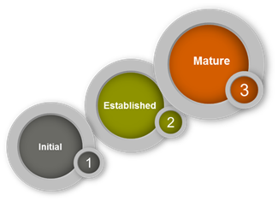

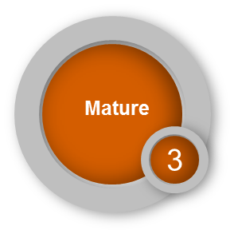
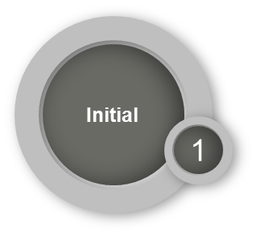
Delivery Model Transformation – Through Hybrid COE
HCOEs
Current Maturity
(CY2017)
Target Maturity
(CY2018)
Plan to Scale & Mature
Targeted Business Benefits
Digital
+ 2 HCOE team under scope
PO Role expansion & 3 SMs at Offshore
Enable Service Virtualization,
In Sprint Regression/Security/Perf. testing
1. Increase in Digital Assets usage
2. Speed to Market – Del. Cycle Time – 10%↑
3. Quality- Defect density (50%↓) & Escape defects (80%↓)
1. Business Value – ePA Penetration (from 22% to >=40%↑)
2. Speed to Market - Del. Cycle Time - 50% ↑ (24 -> 12 wk)
3. Quality – Problem Ticket Influx (50%↓)
PAS
New PODs in Hybrid COE model
Agile Maturity
Clinical
Increased scope
Strengthen Business Engagement
Agile Transformation
1. Business Value: Improve Clinical Efficacy
2.Speed to Market: Delivery Cycle time – 30% ↑
3.Quality: Defect density (0.3)
IRIS
Increased scope
Strengthen Business Engagement
Agile Transformation
1. Speed to Market: Increase Work Order throughput by 40 % (from 5 to 7 Work orders per month) for the Pilot.
Plan
Define
Execute
Sustain & Mature
IVR
Navigator
Clinical
PAS
Digital
Home Infusion
RxClaim
(1 mod)
IRIS
*Legend
New HCOE
Existing
HCOE
Notes:
Ch 2- Add Plan (q1,q2)

Slide 8
Value Delivery – Approach & Plan
Impact these business outcomes
Improve Mail Conversion Ratio
Reduce Cost per Contact
Client Implementation Expense Reduction
Medication Adherence Improvement
EMR Integration TAT Reduction
Cost per Rx
Broad-based Innovation delivering business outcomes
4+ Ideas from OGS included in product roadmap(s)
Tight alignment with segment innovation efforts
OGS C/F Leverage | 2. Rx IT Alignment
3. Portfolio Management | 4. Investments
Create synergies amongst existing OGS teams
MBO/Goal alignment
Closer alignment with DigIT and Innovation Council efforts
By leveraging these levers
Leverage Innovation management framework to drive pipeline management
Strengthen business case appraisal process
Investments in Infrastructure & Resources
Q1
Q2
Q3
Q4
Workshop with OGS c/f teams to get alignment on MBO
Finalize/Agree key business outcomes to address
Create 30-60-90 plans to address opportunities
Develop PoCs for identified opportunities
Socialize with business partners
Develop pilots for validation
Observe pilot performance to finalize operational deployment
Work with business/IT partners to create full-scale capital plans for identified ideas
Following this approach
Notes:
Client Implementation Expense Reduction
Medication Adherence Improvement
EMR Integration TAT Reduction
Cost per Rx

Slide 9




Building Scale through Rx University | Standard Global platform
New Role Development – Architects, Mobile Developers, Data Scientists, Product Owners & Scrum Masters – Aligned to global demand
QE Transformation
Leverage Hybrid COEs experience
Delivery Transformation aligned to Rx Technology Agile Roadmap
New Role Development
Experience
Week 1
Weeks 2-5
Build Technology expertise – DevOps, ATDD, Machine Learning, Ab-initio, KANA
Full stack developers and Cross functional team members – Developers and Testers as Engineers.
Domain Capability Uplift – Continued 10% movement from B to I & 10% from I to A as MBO
Domain Certification Internal Assessment & Industry accreditation
Adv. Technology
& Full-Stack
PBM
Domain
Rx University
Goal Post
150
3
90
25
Quality Engineers
DevOps Proof Of Concepts
Practicing Scrum Masters
Certified PBM SMEs
Notes:
Ch3- Add Plan

Slide 10
People Focus & plan
Business and Developments Goals completion by (10th February)
Culture
Drive United Culture and Live to the Values of the Organization
1
4
Performance
Culture
100% completion of business & Development goals for all employees joined as on 31st Dec 17
100% Top Talent (5 Raters) on stretch goals and assignments
NI Management (39 no CR17 – 5%)
100% attendance of Grade 28 completion of Values workshop.
1 Culture Facilitator from Optum Rx end of 2018
2
QA to QE
Agile Org Structure
Talent Rotation (Global)
5
Stretch projects for Hi potential employees across grades
Instant Rewards
Talent Transformation
Retention
80% of QA to be QE end of Dec 18
Structure of scrum teams
Global Rotation of employees – short term, long term, transfers
95% Retention of Top Talent
95% Retention of TDP/CHP for 1st Year
<10% overall attrition (90% retention)
100% consumption of Bravo
Quarterly workshops in collaboration with TD on Accountability, Trust, HI performance culture
1:1 Mentoring for identified potential talent in SG 28
Leadership connect calendar & Manager connect
Communication (Town Halls & Mailers)
Competency building & Optum Rx Induction
Engagement volunteers from the team
3
6
Manager
Effectiveness
Employee
Engagement
28+ & Critical Roles of 27 above to go through the Workshops.
Employee Engagement @ 83%
Manager Effectives @ 81%
90% of the Managers to have >70% Manager effectiveness scores.

Slide 11
Appendix

Slide 12
OptumRx – MBO’s

